Slide 1
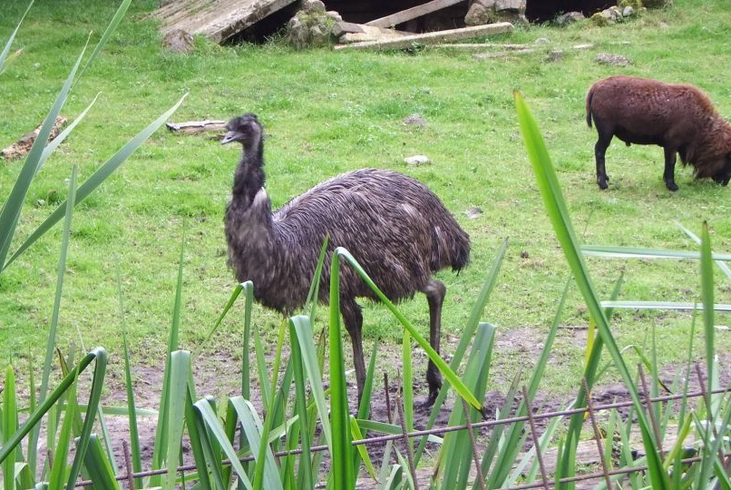
EMU Value-Added Catalogue (EVACat)
Nick Seymour | Future Fellow
29 May 2012
CSIRO Astronomy & space Science

Slide 2
Over-view
Basic EMU data products (Level 5) released immediately to the public

Slide 3
Over-view
Basic EMU data products (Level 5) released immediately to the public (EMU Data Requirements v2):
UV data (all 4 stokes and all 300? channels)
Image data (Stokes-I and next 2 Taylor series terms, Residual, Coverage, PSFs plus meta data, Mask Image)
Component Catalogue (unique IAU identifier, RA & dec. of peak, error on RA & dec., total/peak flux, total/peak spectral index, spectral index curvature, parameters of Gaussian fit, dynamic link to postage stamp server)

Slide 4
Over-view
Basic EMU data products (Level 5) released immediately to the public
EMU is committed to releasing a ``value-added’’ catalogue to the public (multi-λ and derived products)
VO accessible and to be hosted by ICRAR (and elsewhere?)
Each release to be well documented (journal paper for first release)
Test with ATLAS DR3 (and maybe survey with BETA or ASKAP18)

Slide 5
EVACat Open Questions
Multiple host locations?
Timing of releases compared to fraction of survey complete?
Which data products will we include?
What is our data policy?
How will we coordinate with other surveys?

Slide 6
XID
DRAFT

Slide 7
Straw-man Plan
DRAFT

Slide 8
EMU in 3D – statistical redshifts

Slide 9
EMU in 3D – statistical redshifts

Slide 10
EMU in 3D – statistical redshifts
Provide estimates of redshifts, or lower limits, with well characterised uncertainties and reliabilities for all 70 million EMU sources.
Methods to test
Classical template fitting
Machine learning
k^{th} nearest neighbour (kNN)
Self-organised map (SOM)
Gaussian Process (GP)
Self Vector
Mean/median of all methods

Slide 11
EMU in 3D – statistical redshifts
Testing
Idea is not to find the `best’ method
Include radio properties (flux, spectral index, polarisation etc.)
Machine learning may work better with fewer, more heterogeneous data
Template fiting may give derived parameters, e.g. SFR, extinction
EVACat:
Ultimately modular, automated code
Rerun as new ancillary data becomes available
Update EVACat
3 test fields:
COSMOS
GAMA + WiggleZ
ATLAS DR3
More spectra in ATLAS fields

Slide 12
Updates to draft memo:
Determine which data products included with which release?
Differentiate between data just cross-matched and then data derived (e.g. diff between FLASH flux and EMU/FLASH spectral index).

Slide 13
Discussion:
What is our data policy?
- how long do we keep data for ourselves?
- inclusion of data products depends on timing/data policies of other groups
How do we make new images with single-dish data available?
How will we coordinate with other surveys?
- does EMU require products which are not in the default plan of other projects (e.g. low SNR polarisation measurements?)
- same policy for EMU/POSSUM/WALLABY/FLASH?
- lag between catalogue completion and release
- email EMU publication policy to Bryan
- EMU ASKAP = Level 6 = EMU Basic/Public/Initial Catalogue

Slide 14
Thank you
CASS
Nick Seymour Future Fellow
t +61 293 724 284
e nicholas.seymour@csiro.au
w http://www.atnf.csiro.au/people/Nick.Seymour
CSIRO Astronomy & Space Science

