Slide 1
ASKAP polarisation calibration and characterisation: The state of play
Craig Anderson | Bolton Fellow | CSIRO
POSSUM busy week, May 2019
CSIRO Astronomy and Space Science, Perth astrophysics group

Slide 2
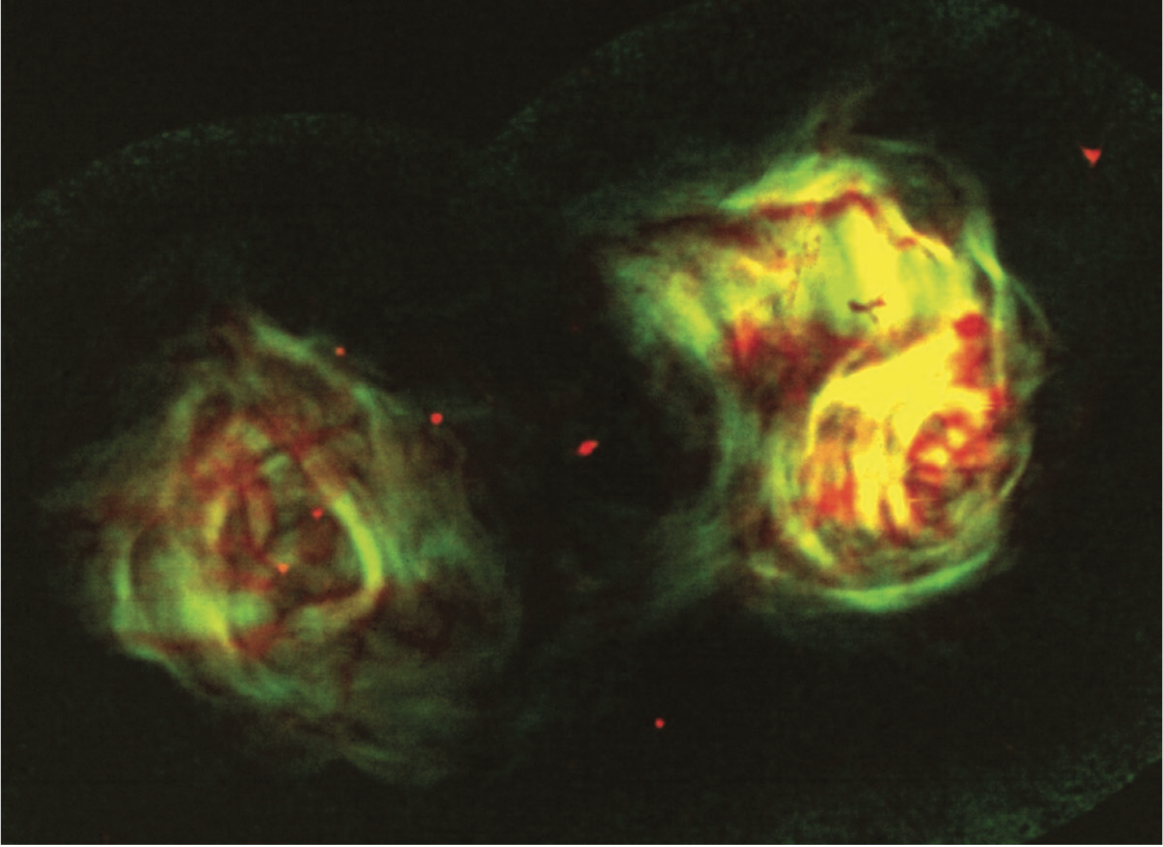
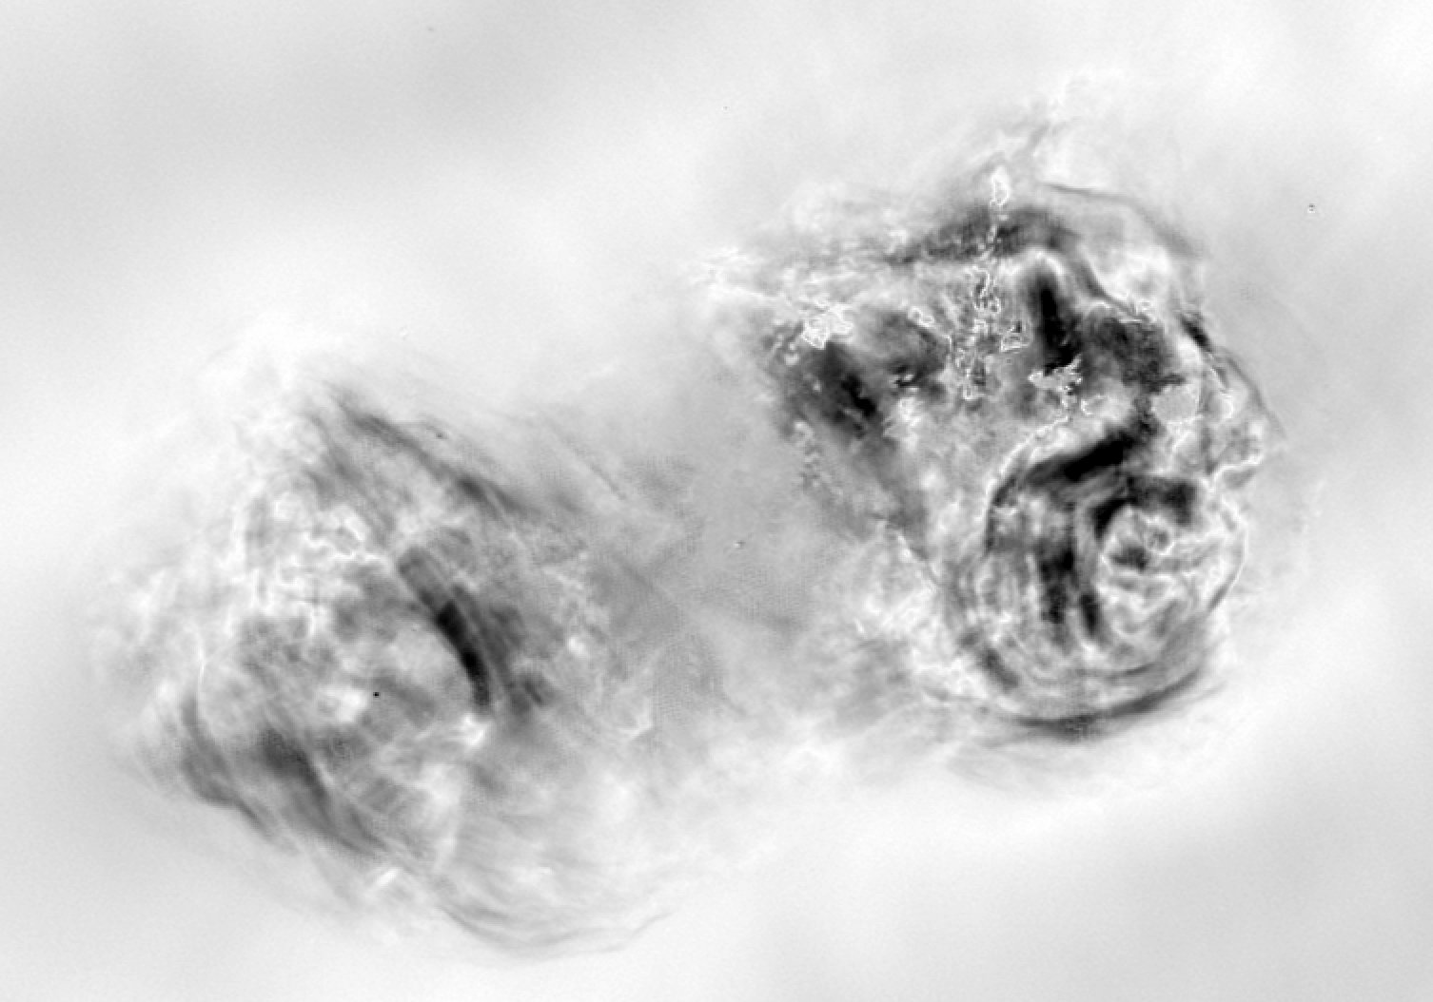
Whetting the collective appetite…
Fomalont+ (1995)

Slide 3
Whetting the collective appetite…
(FORNAX A / P / ASKAP-36 / Anderson, Lenc)

Slide 4
Whetting the collective appetite…
We now have deep (~10s -- 100 uJy/b), full-pol ASKAP-36 obs ‘in the can’ for fields:
— The LMC, SMC
— GAMA fields: G09, G12, G23
— SHAP1
— SPARCS nth
— SCORPIO (Gal. field; 0.8, 1.4 AND 1.6 GHz)
— ERIDANUS
— FORNAX
— SN1006
.
.
.
PLUS…
— The whole southern sky (Rapid ASKAP Continuum Survey; ~250 uJy/b in Stokes I; likely better in pol) .

Slide 5
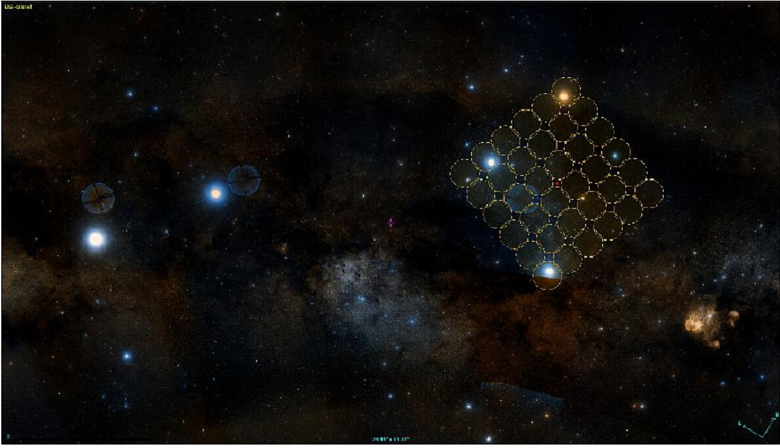
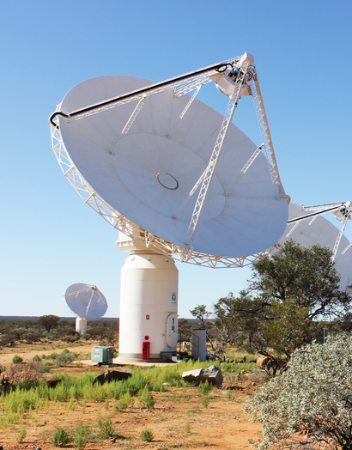
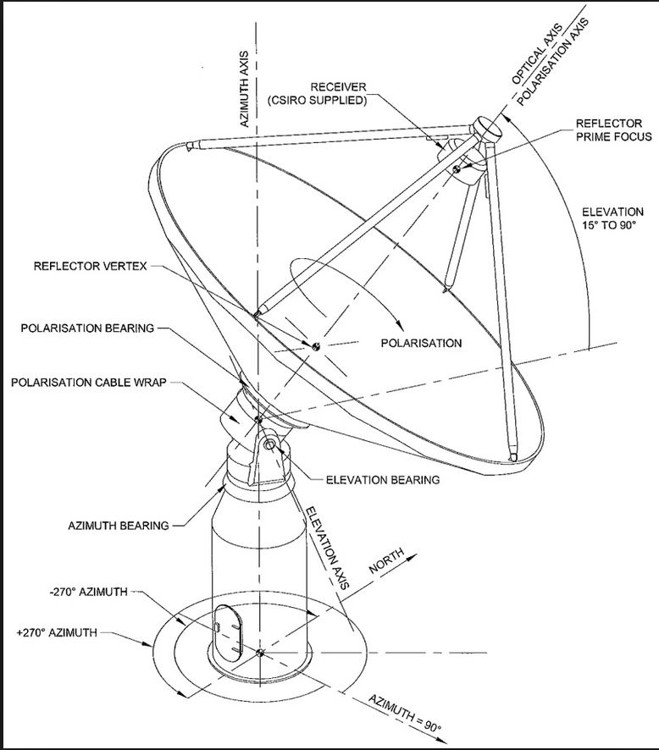
The ASKAP philosophy

Slide 6
The ASKAP POL CAL philosophy
- No pol/sec cals for ASKAP observations (overheads for 36 beams)
- So:
Flux + bp + (on-beam-axis) leakage from B1934-638 primary cal
- But still need to cal:
XY phase (1934 is unpolarised)
Off-axis pol response
Ionospheric Faraday rotation
- XY phase is the big first order effect
- Use ‘rotated PAFs method’ to solve for (”process_polcal.py” pipeline)

Slide 7
The ASKAP POL CAL philosophy
- No pol/sec cals for ASKAP observations (overheads for 36 beams)
- So:
Flux + bp + (on-beam-axis) leakage from B1934-638 primary cal
- But still need to cal:
XY phase (1934 is unpolarised)
Off-axis pol response
Ionospheric Faraday rotation
- XY phase is the big first order effect
- Use ‘rotated PAFs method’ to solve for (”process_polcal.py” pipeline)
OBSOLETE!

Slide 8
Where we’re at: Current methods and results for pol processing

Slide 9
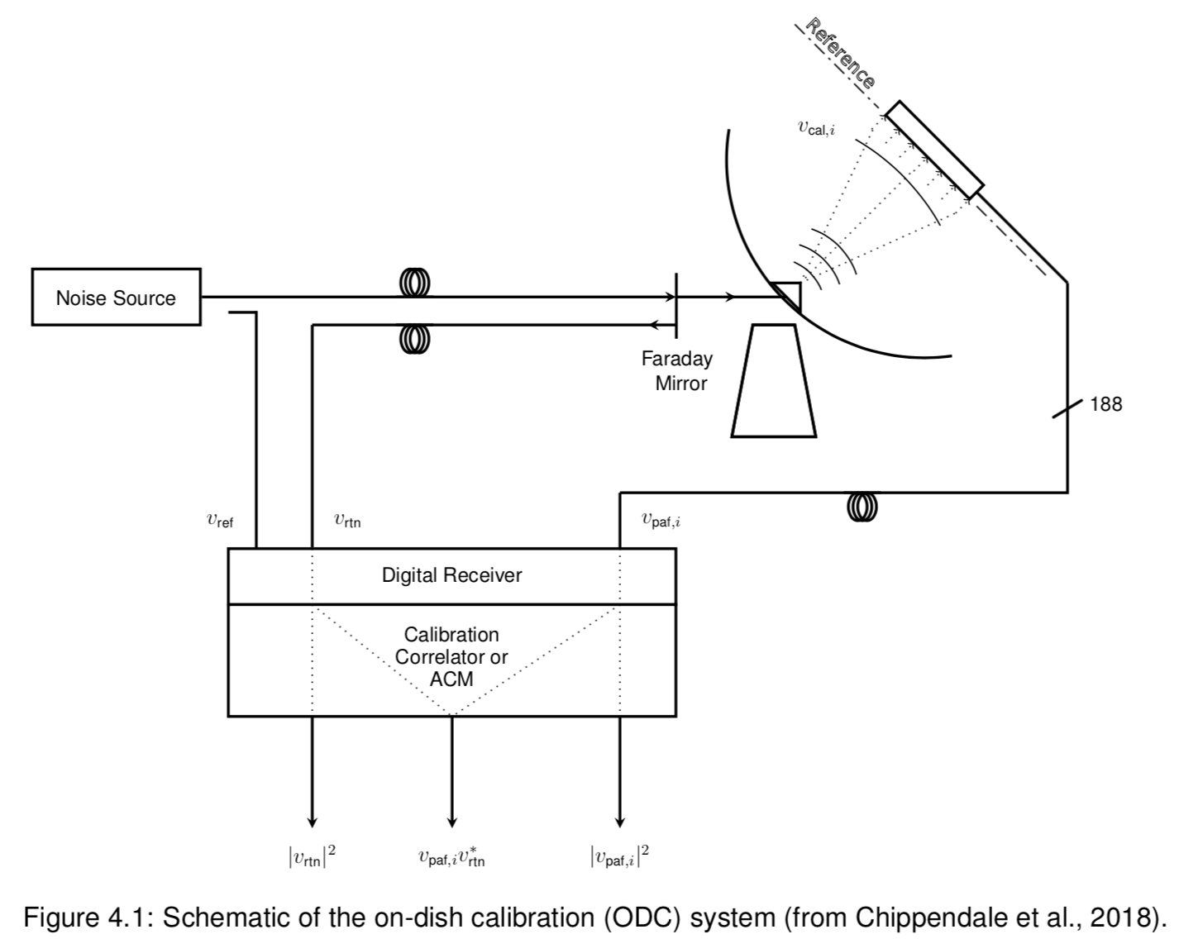
XY-phase cal directly via beamforming
ASKAP on-dish noise radiator (ODC)

Slide 10
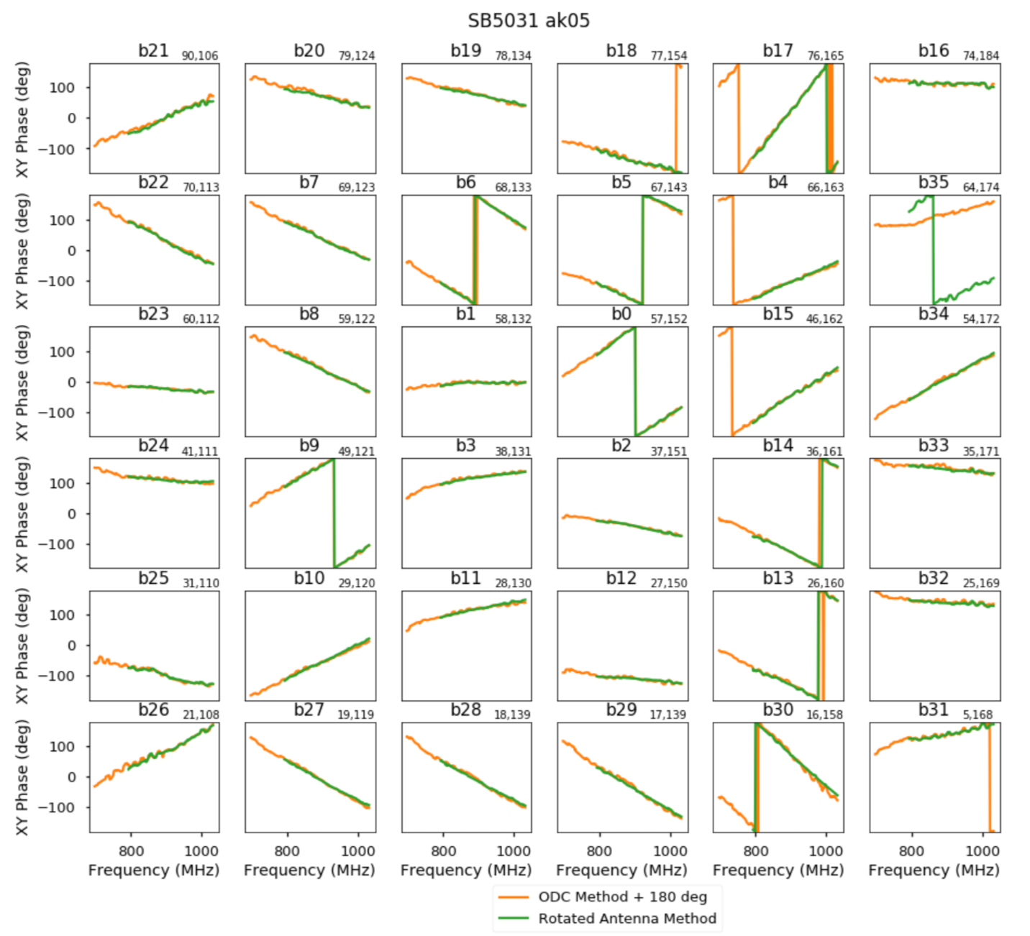
XY-phase cal directly via beamforming

Slide 11
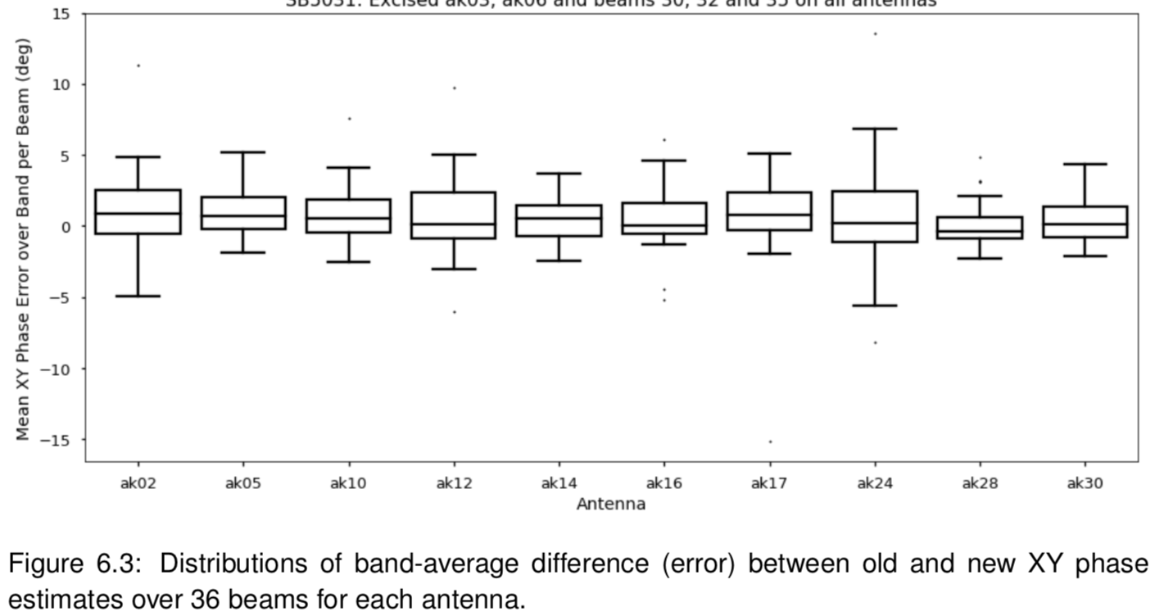
XY-phase cal directly via beamforming

Slide 12
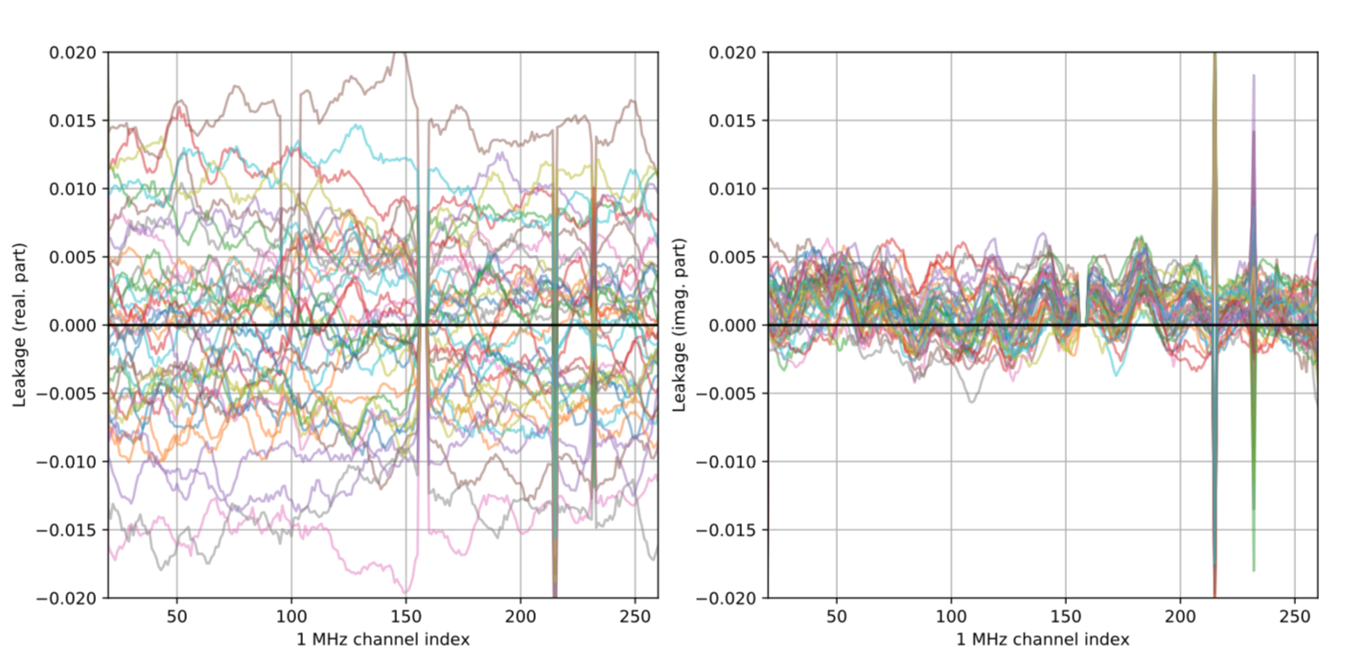
Uncalibrated on-axis leakages, post beamforming

Slide 13
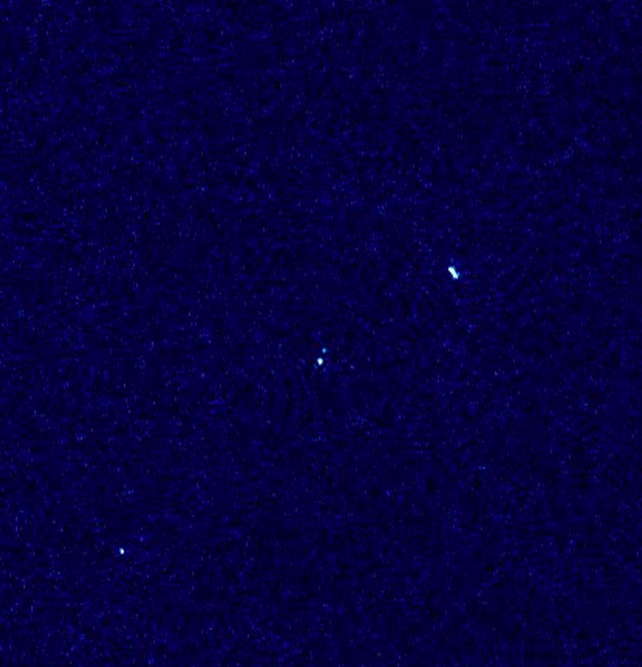
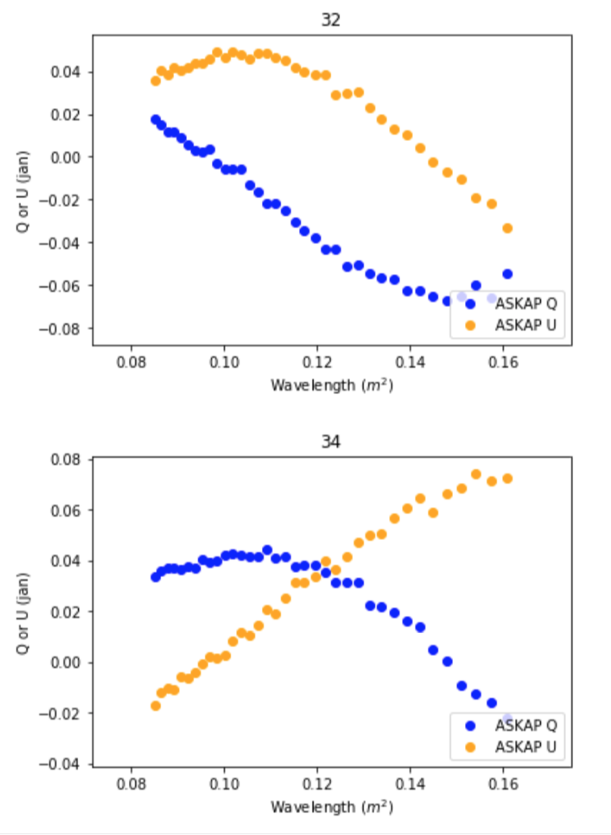
Pol data quality (post-on-axis cal)
P
(Lenc, Heald, Anderson, Gaensler)

Slide 14
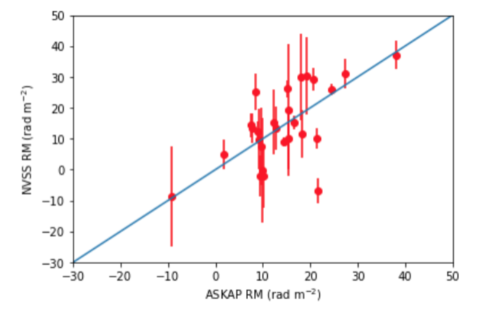
Pol data quality (post-on-axis cal)
NVSS vs. ASKAP RMs

Slide 15
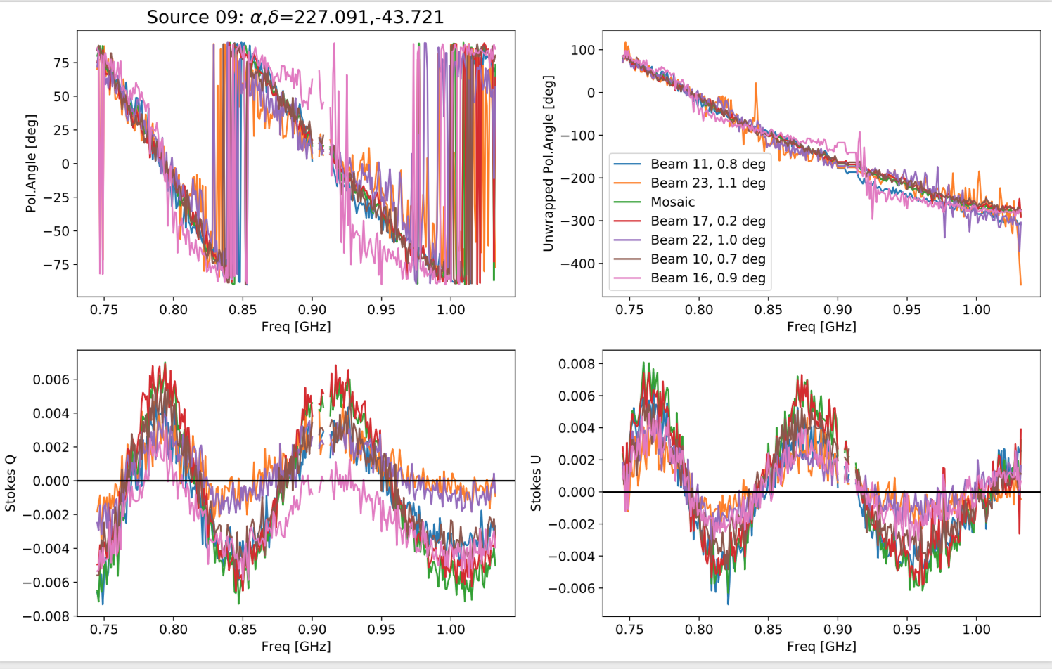
Angle consistency b/w beams
Off-axis leakage characterisation / mitigation / correction
Credit: Cameron van Eck

Slide 16
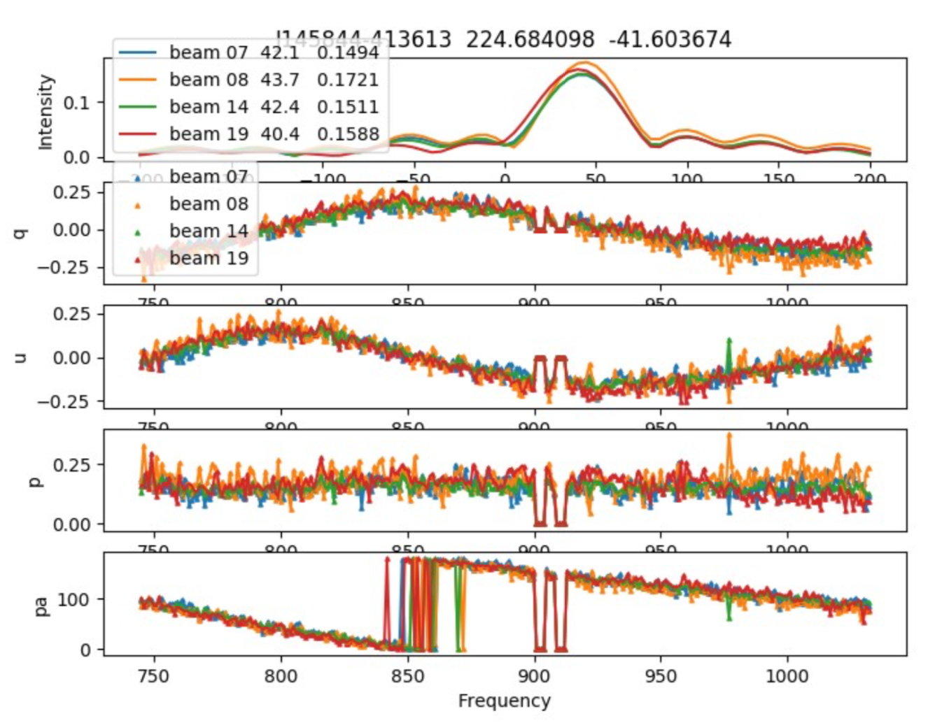
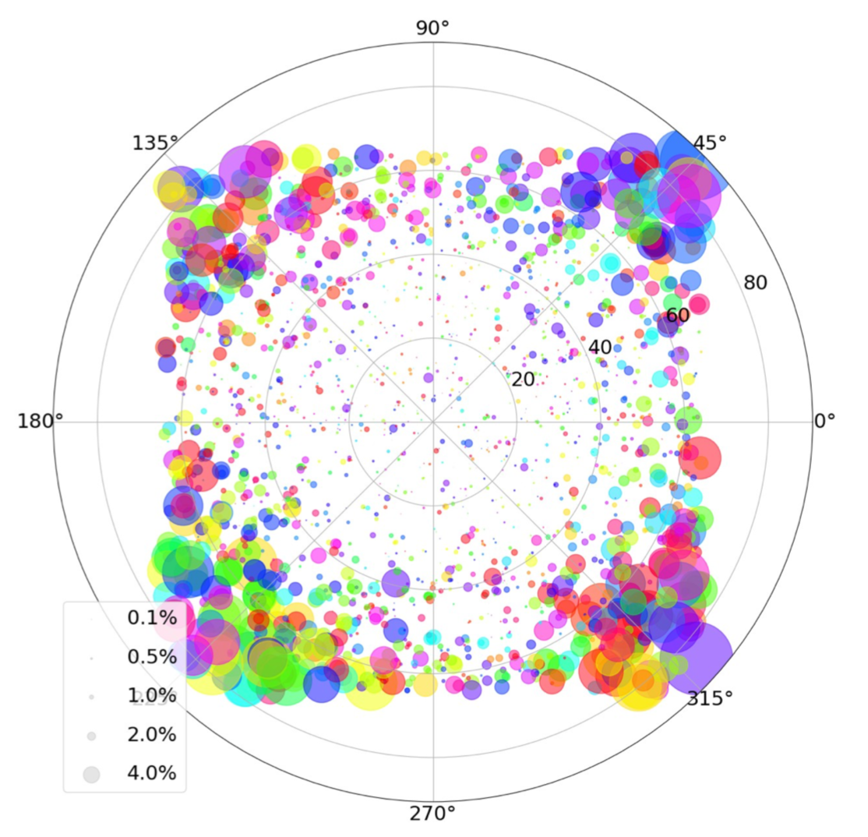
Frac. pol. vs. beam position
Off-axis leakage characterisation / mitigation / correction
Credit: Xiaohui Sun

Slide 17
Where we’re going: Impending/future methods and measurements for ASKAP pol. obs.

Slide 18
Leakage considerations
POSSUM Spec:
- 0.3% of Stokes I (required)
- 0.1% desirable

Slide 19
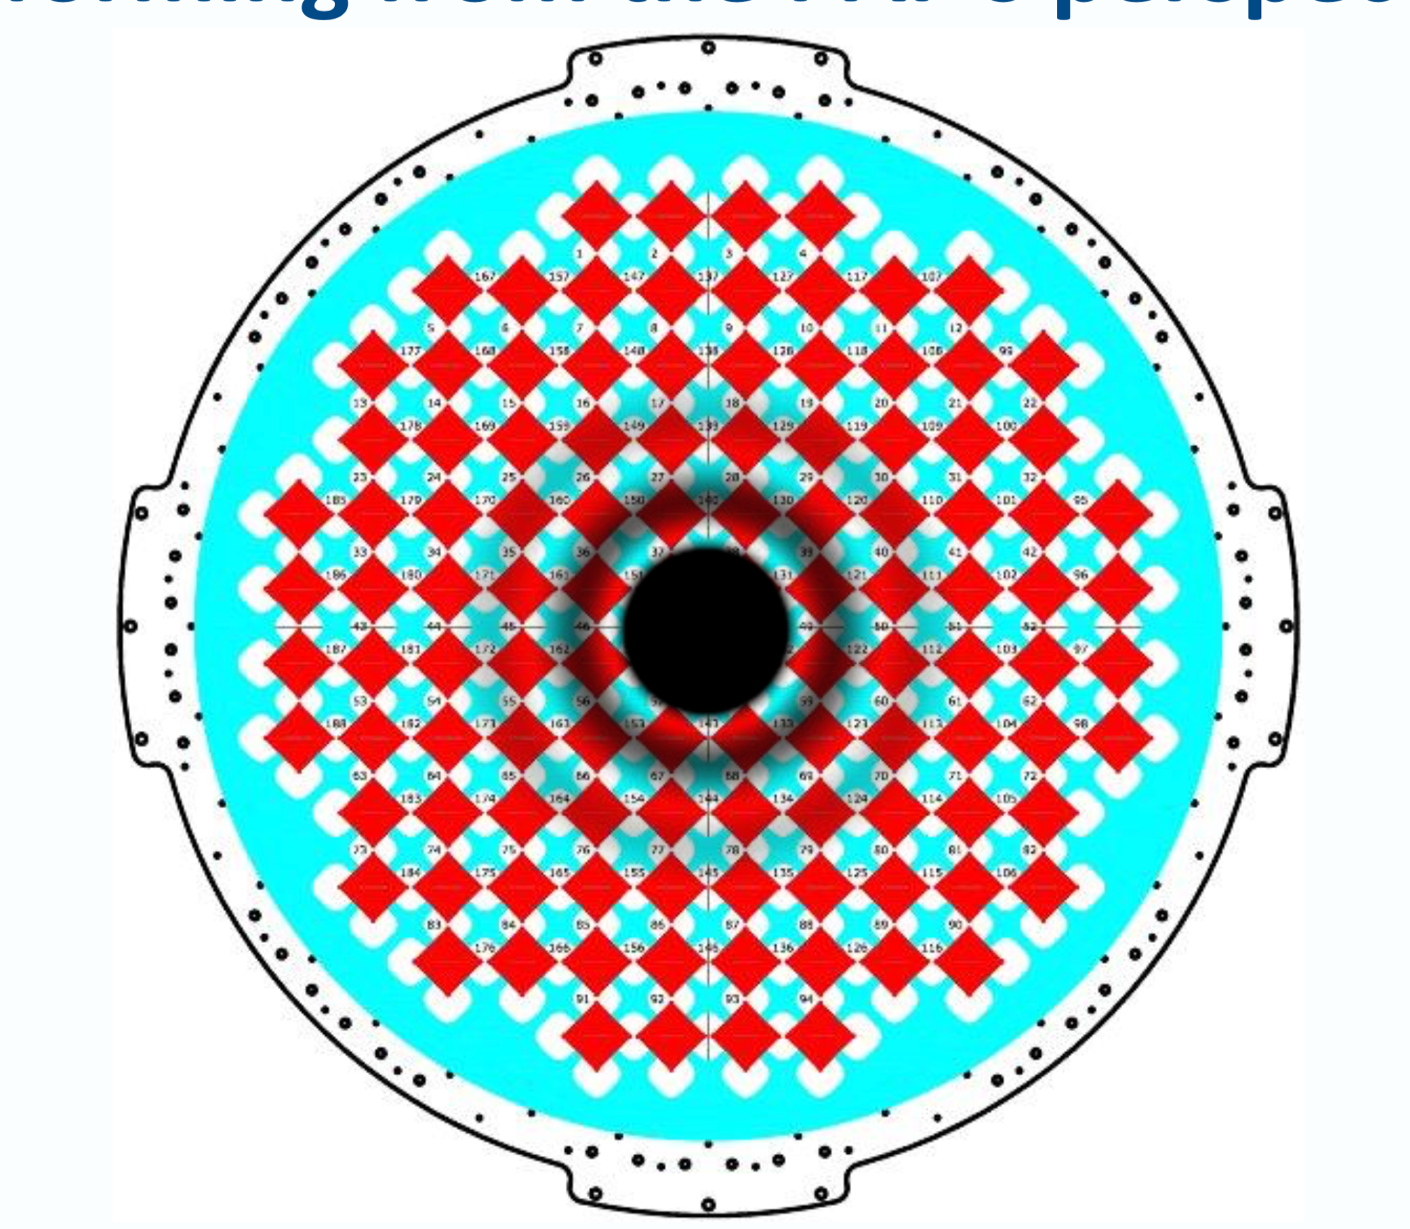
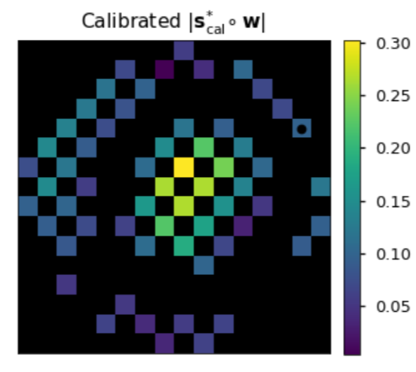
Possibility to calibrate on-axis leakage via beamforming

Slide 20
Possibility to calibrate off-axis leakage via beamforming
Max S/N beam
ASKAP-12 holography (Hegarty + Hotan)
Shape constrained beam

Slide 21
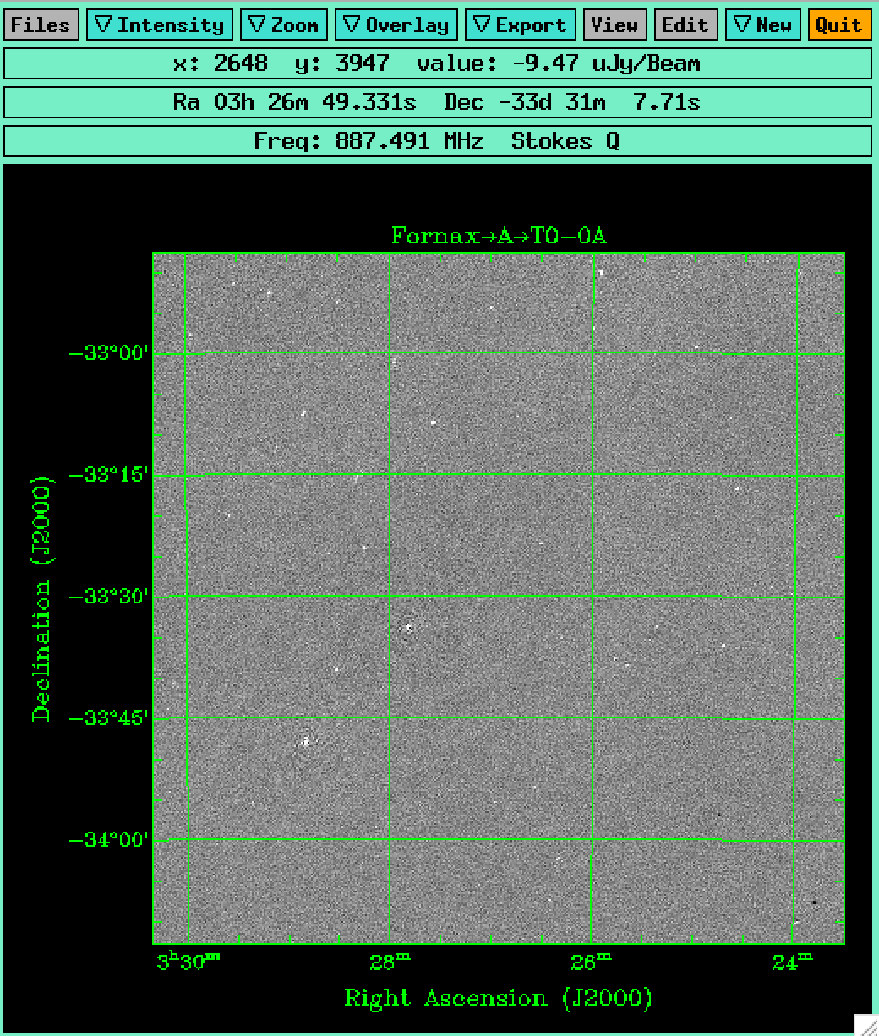
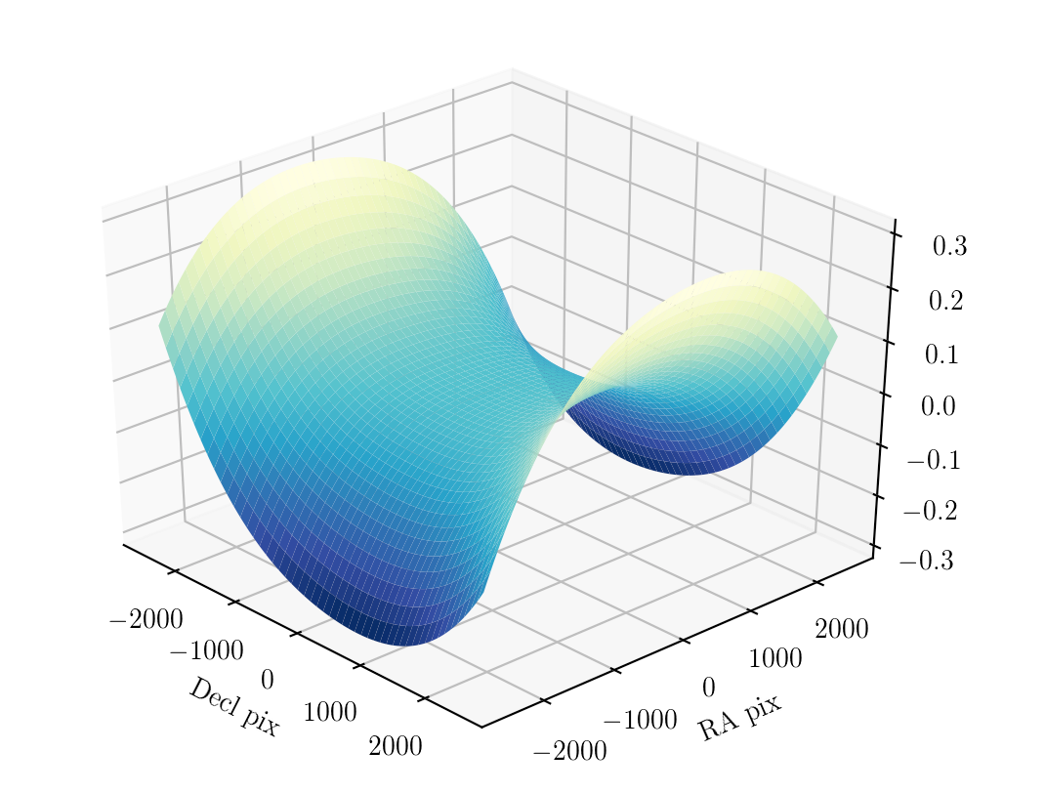
Alternative: Off-axis pol corrections in image plane
Alternative: Off-axis pol corrections in image plane
(Anderson)
Uncorrected

Slide 22
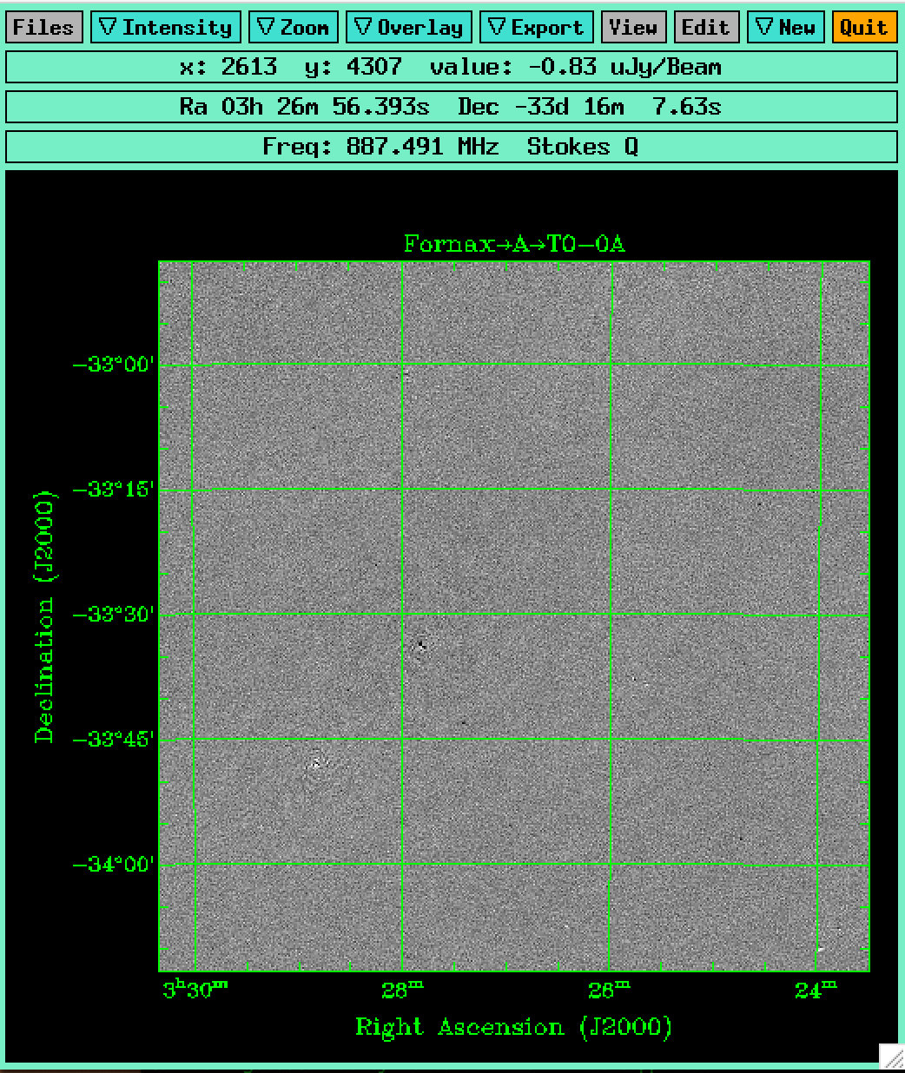
Alternative: Off-axis pol corrections in image plane
Corrected

Slide 23
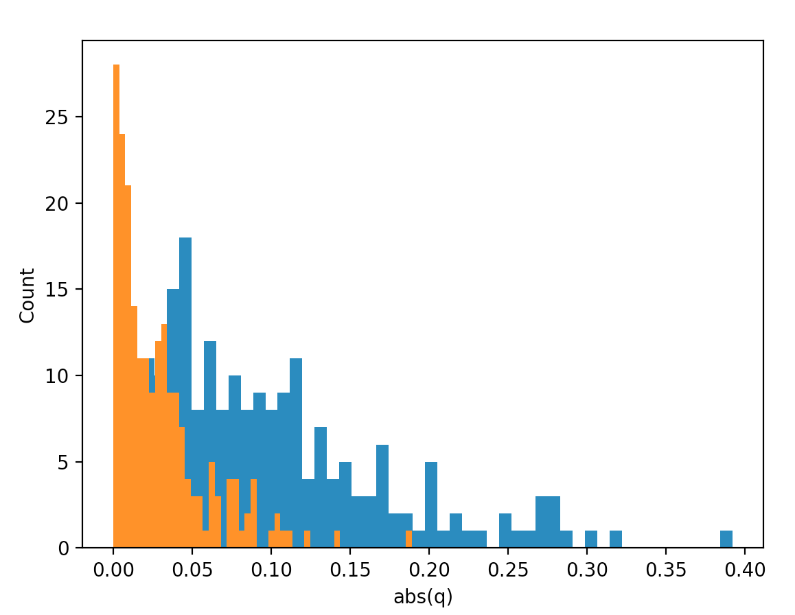
Alternative: Off-axis pol corrections in image plane
Uncorrected
Corrected

Slide 24
(Eventual) alternative (?): AW-projection
- The ‘correct’ way
- Being investigated (Chris Skipper), but too computationally expensive to implement for routine ASKAP proc?
- Certainly will not be available for RACS or the SST pilots

Slide 25
Practical outstanding issues

Slide 26
Calibration: Incorporate on-axis leakage cal. in ASKAP data proc. pipeline
- We do not do this yet, but we soon need to
- ASKAPsoft can do it, so should be a relatively straight-forward re-tooling of the pipeline. But some issues like: freq dep, or freq indep? Verification/tolerances prior to pol imaging?
- I have ‘bolt on’ python scripts that can do it. Interim solution for RACS, or unnecessary (modding the normal PL is quick and easy enough)?

Slide 27
Calibration: Abs. pol. angle
- We do not do this yet, but we soon need to
- POSSUM spec. left unspecified (1 deg. accuracy listed as ‘desirable’)
- Methods: On-dish cal system? Pseudo-one-time (e.g. at beamforming) pol. cal. visit? If so, then what (e.g. Lunar rim, point source)? More elaborate strategy?

Slide 28
Calibration: Off-axis cross-pol response
- We do not do this yet, but we soon need to
- POSSUM spec: Good to 0.3% of Stokes I across the field
- Will need a detailed plan + concerted effort to characterize, correct, and verify.
- Methods: Image plane correction most probable for RACS and pilot (as discussed above), and characterization discussed more below.

Slide 29
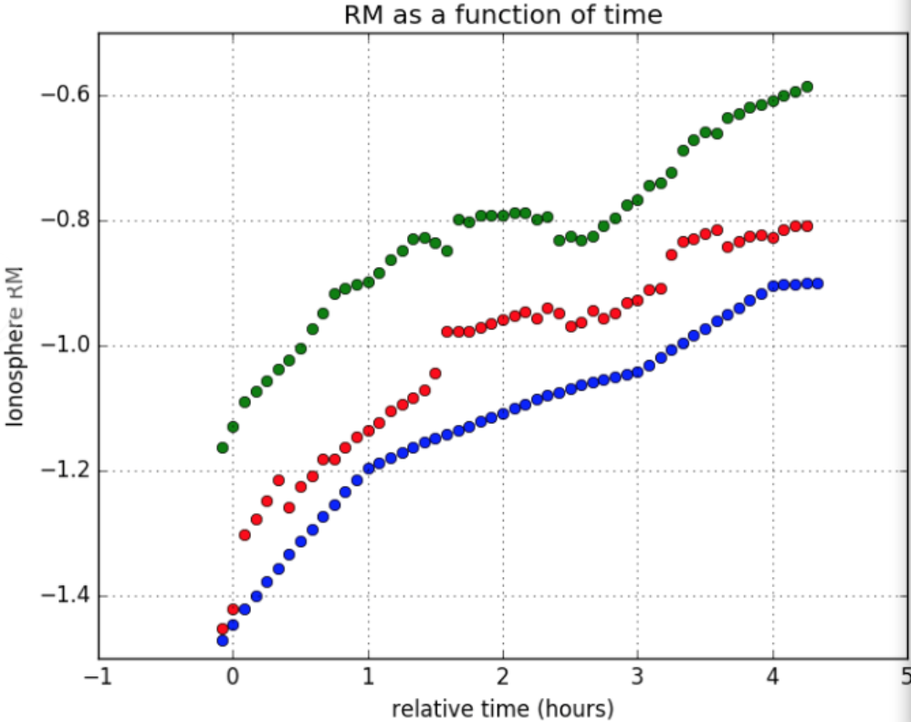
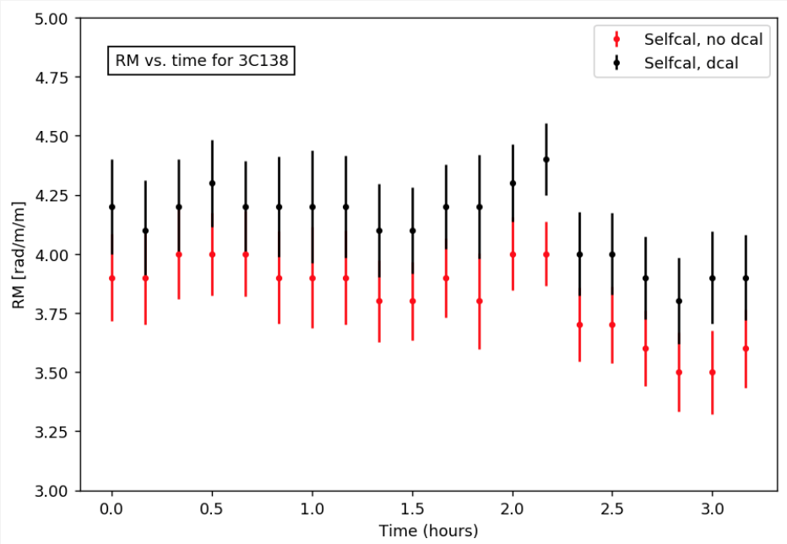
Calibration: Ion. FR
- We do not do this yet, but will eventually need to
- Currently at Solar minimum, so hard to even detect, let alone correct and verify
- Methods: As discussed in detail ~2 POSSUM bw’s ago. Visibility correction with some as-yet unspecified cadence would be best-practice
Credit: Tony Willis
Credit: Chris Riseley

Slide 30
Data proc: Channelisation + CLEANing
- Pol. data cubes are imaged and CLEANed in 1 MHz channels, with only a limited form of masking available (two-step shallow-then-deep CLEAN; deep CLEAN at position of shallow clean comps on a per image basis)
- NOT IDEAL! (only allows for ‘proper’ decon. of bright-ish point sources; syn. beam. artifacts clearly visible post RM-synthesis for middle-bright sources, no ‘complex clean’).
- Could image in coarser channels, but trade-off with sensitivity to high RMs (esp. in low freq band; ~700 MHz low edge freq.), and is ‘kicking the can down the road’ in some sense
- More sophisticated methods exist or have been proposed (cf. wsclean -- ‘broadband squared-channel + polarisation joining’; GH’s ‘RM synthesis CLEAN’ idea) that reduce the effect of the choice of channelization, but these are not on the SDP radar right now.
- Need to decide on best (read: satisfactory + realistic) approach.

Slide 31
Data proc: Common-resolution convolution
- Data cubes are imaged up in 1 MHz chans at their ‘native resolution’, which is freq-dependent
- Can specify a common freq indep restoring beam, but this is bad practice for several reasons
- Need to convolve the CEANed maps to a common resolution (LR would say we need to convolve the DIRTY maps to a common resolution ?!)
- We have custom scripts for this, which we’ll likely need to ‘bolt on’ to the pipeline, esp. for RACS data proc.

Slide 32
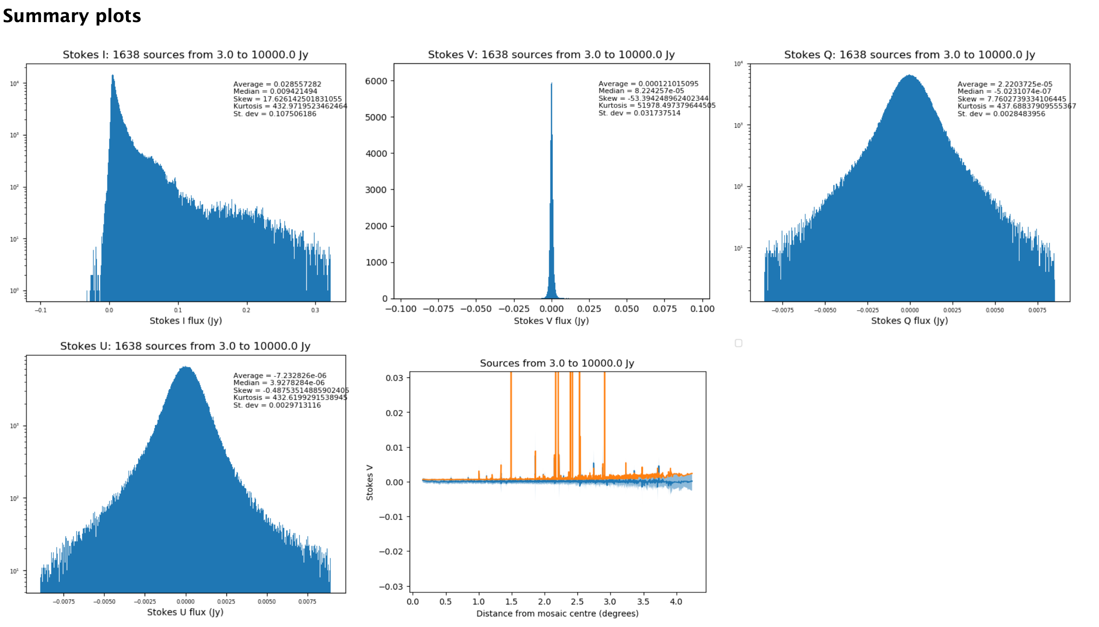
Data proc: Polarisation DQA
Credit: Jennifer West

Slide 33
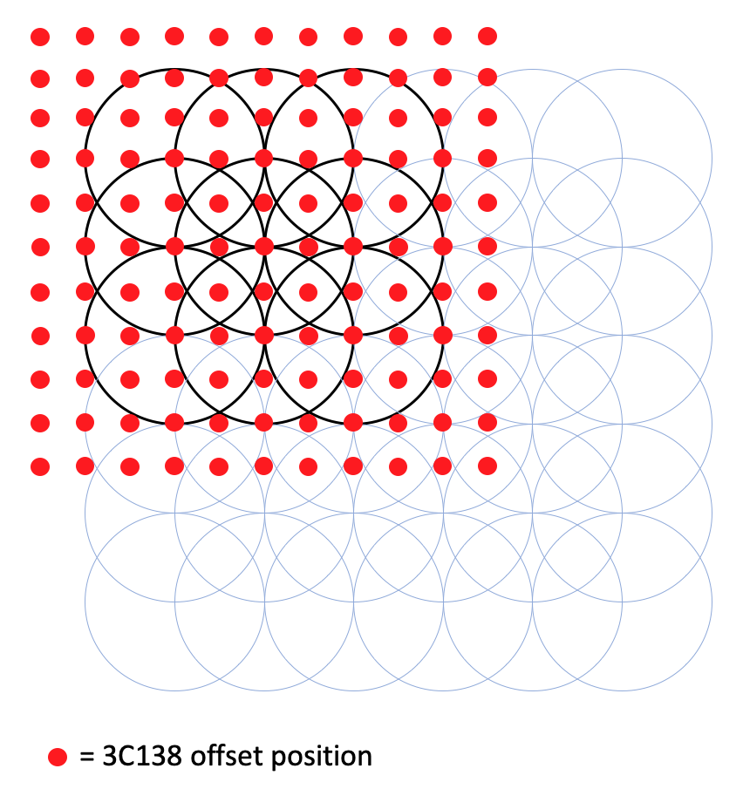
Characterisation: Off axis leakage
- Further off-axis leakage characterisation: Pol cal “raster” scan across ¼ of the beam footprint

Slide 34
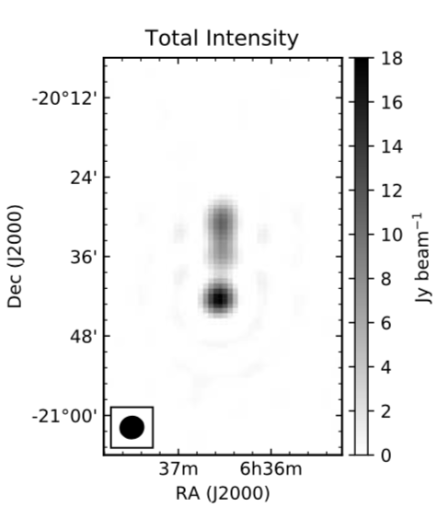
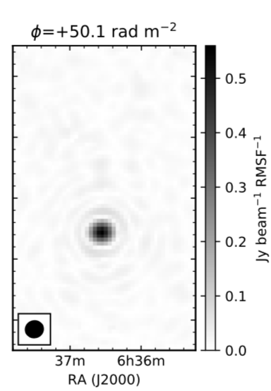
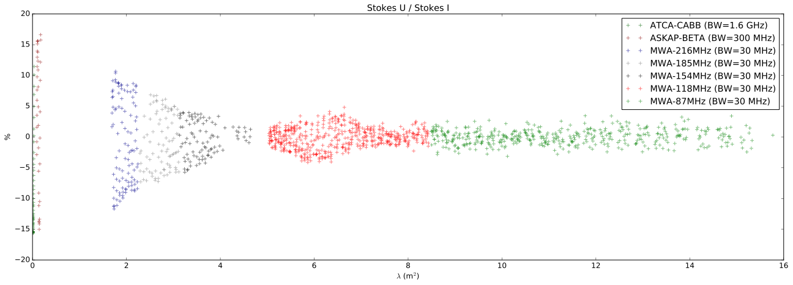
Characterisation: Ion. FR
- Joint MWA-ASKAP tracking of ‘exclamation mark source’ for ionospheric FR detection/correction

Slide 35
Take-aways
- ASKAP is an excellent polarisation machine
- PAFs provide exceptional performance and versatility for full-pol observing
Selected issues requiring better implementation/further thought:
- How to channelise + CLEAN full-pol datacubes
- Flagging consistency across beams, sky area, Stokes params
- Pol-specific automated DQA
- AW-projection for off-axis full-Stokes imaging?
- Absolute angle calibration
- Exact implementation of IFR correction

